Slide 1
Handwritten Equation Recognizer
CAB420 – Machine Learning
Final project
William Jussiau
Johnson Loh
David Schmidt

Slide 2
Introduction
Data acquisition and pre-processing
Clustering
Classification
Demonstration

Slide 3
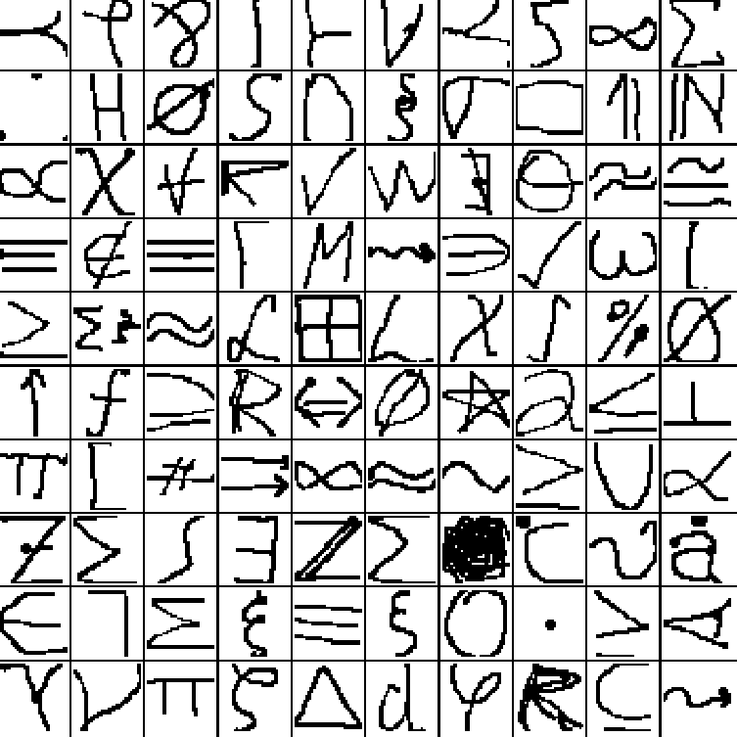
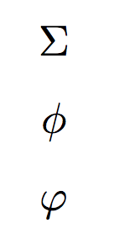
Data acquisition and pre-processing
Database: HASYv2
Thoma, M. (2017) “The HASYv2 dataset”
32x32, black and white images
369 classes
168’233 images
“Two different symbols can have the same glyph” (\sum, \Sigma)
“Two different glyphs can correspond to the same semantic entity” (\phi, \varphi)

Slide 4
Clustering (1)

Slide 5
Clustering (2)

Slide 6
Classification (1)

Slide 7
Classification (2)

Slide 8
Demonstration

